Slide 1
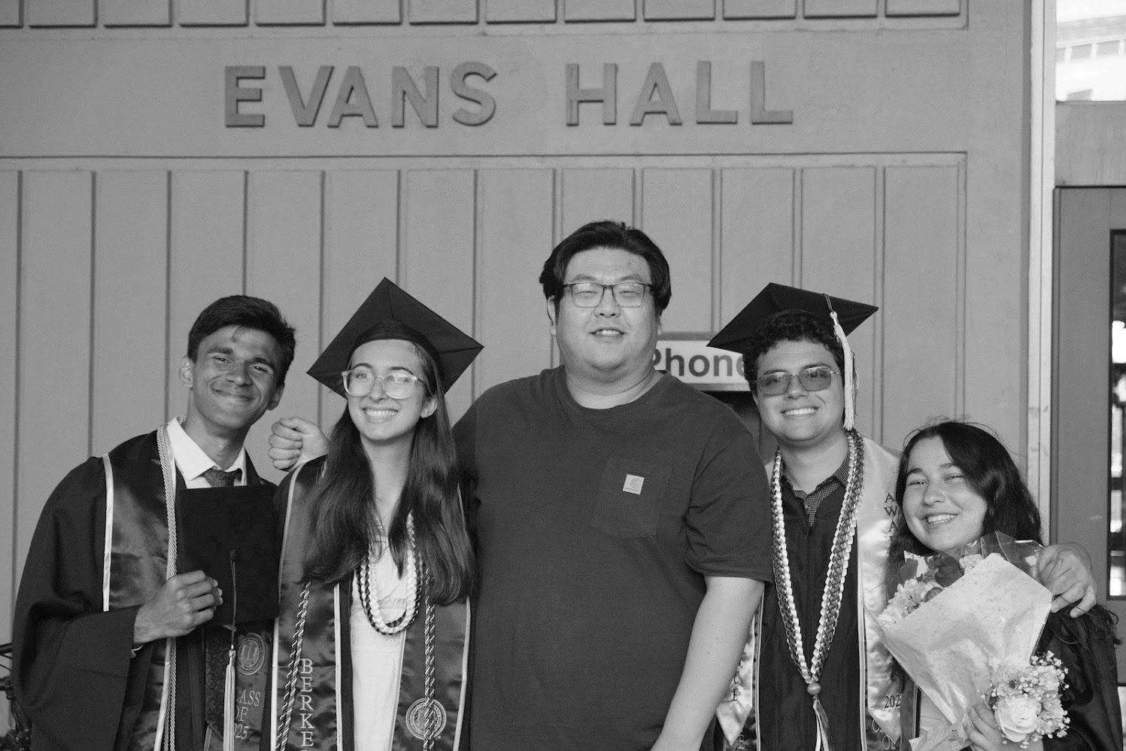
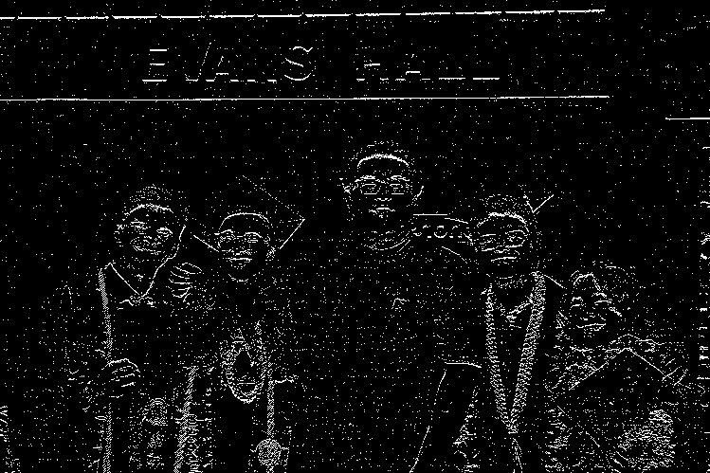
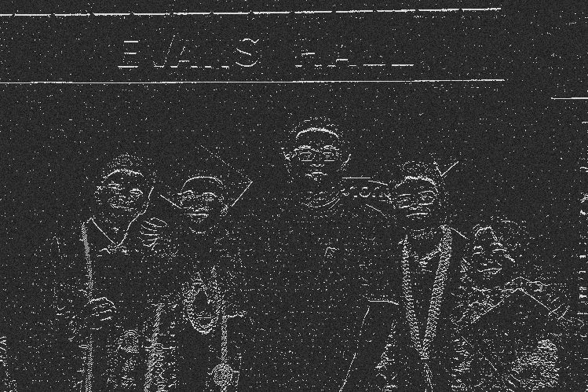
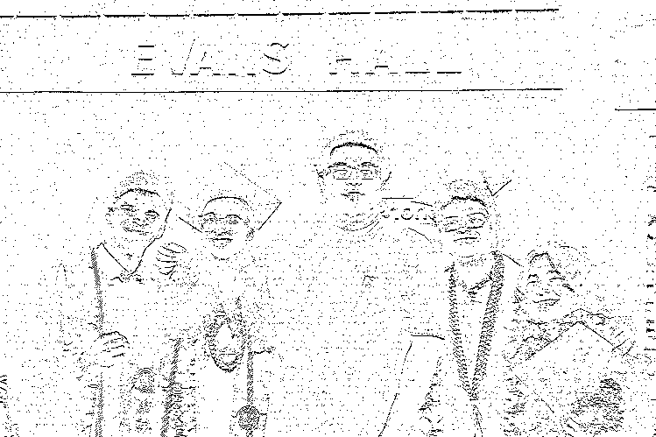
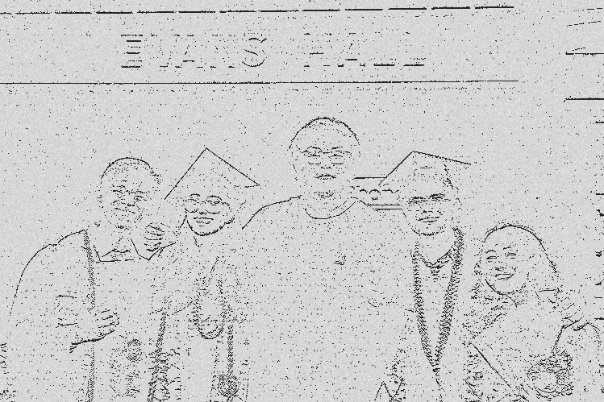
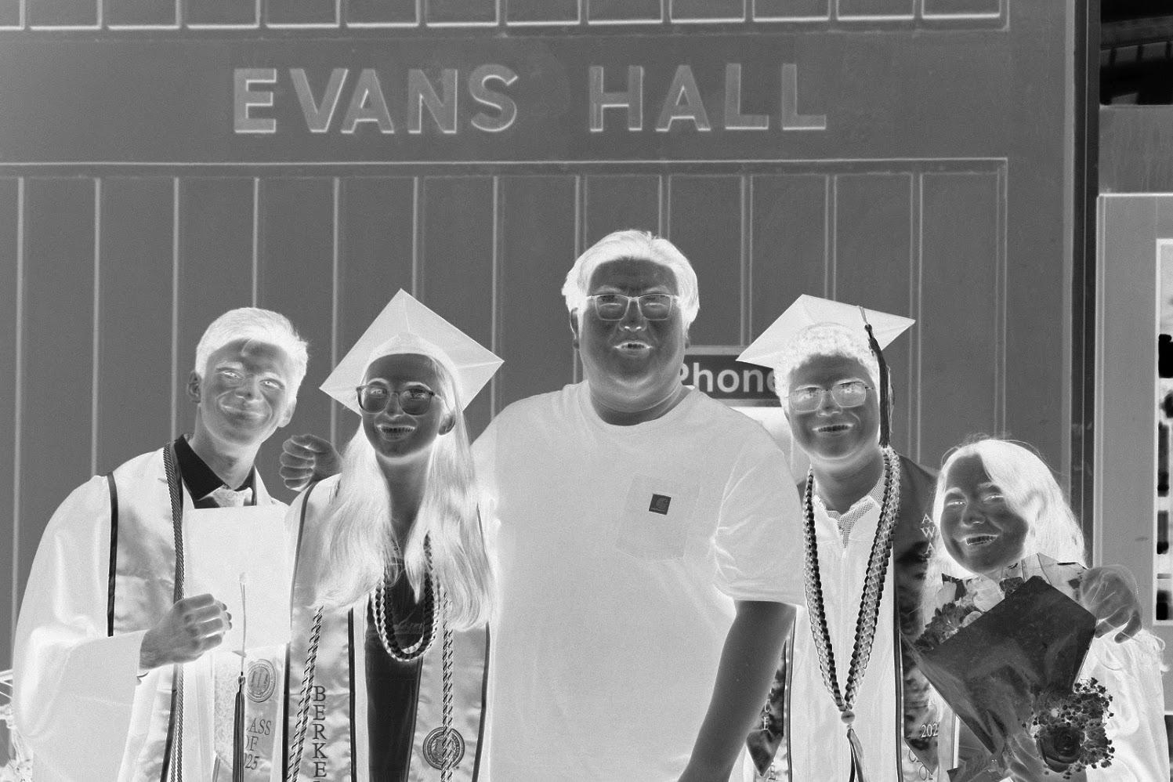
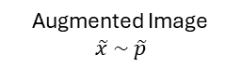
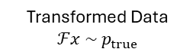


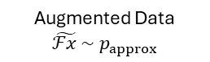
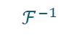
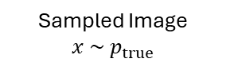


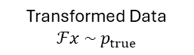



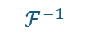
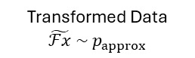
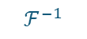
Sampled Image
$$x \sim { p}_{true}$$
Observable
Transformed Data
$$ℱx \sim { p}_{true}$$
$$Y=ℱx+ε$$
$$ℱ$$
$+$Measurement noise$ε$
Ideal Model
$$ℱ^{−1}$$
*Full Bayesian Pipeline
Transformed Data
$$ℱx \sim { p}_{true}$$
Augmented Data
$$\tilde{ℱx }\sim { p}_{approx}$$
Data Augmentation
Make Observation
$$\tilde{Y}=\tilde{ℱx}+ε$$
Augmentation post hoc
(Method used in paper)
$$ℱ$$
$$ℱ^{−1}$$
*Inverse Data Augmentation
Full Bayesian Pipeline
Augmented Image
$$\tilde{x} \sim \tilde{p}$$
Transformed Data
$$\tilde{ℱx} \sim { p}_{approx}$$
Make Observation
$$\tilde{Y}=\tilde{ℱx}+ε$$
Augmentation ante hoc
(Equivalent Method)
Image Augmentation
$$ℱ$$
Inverse Image Augmentation
$$ℱ^{−1}$$
Full Bayesian Pipeline

Slide 2
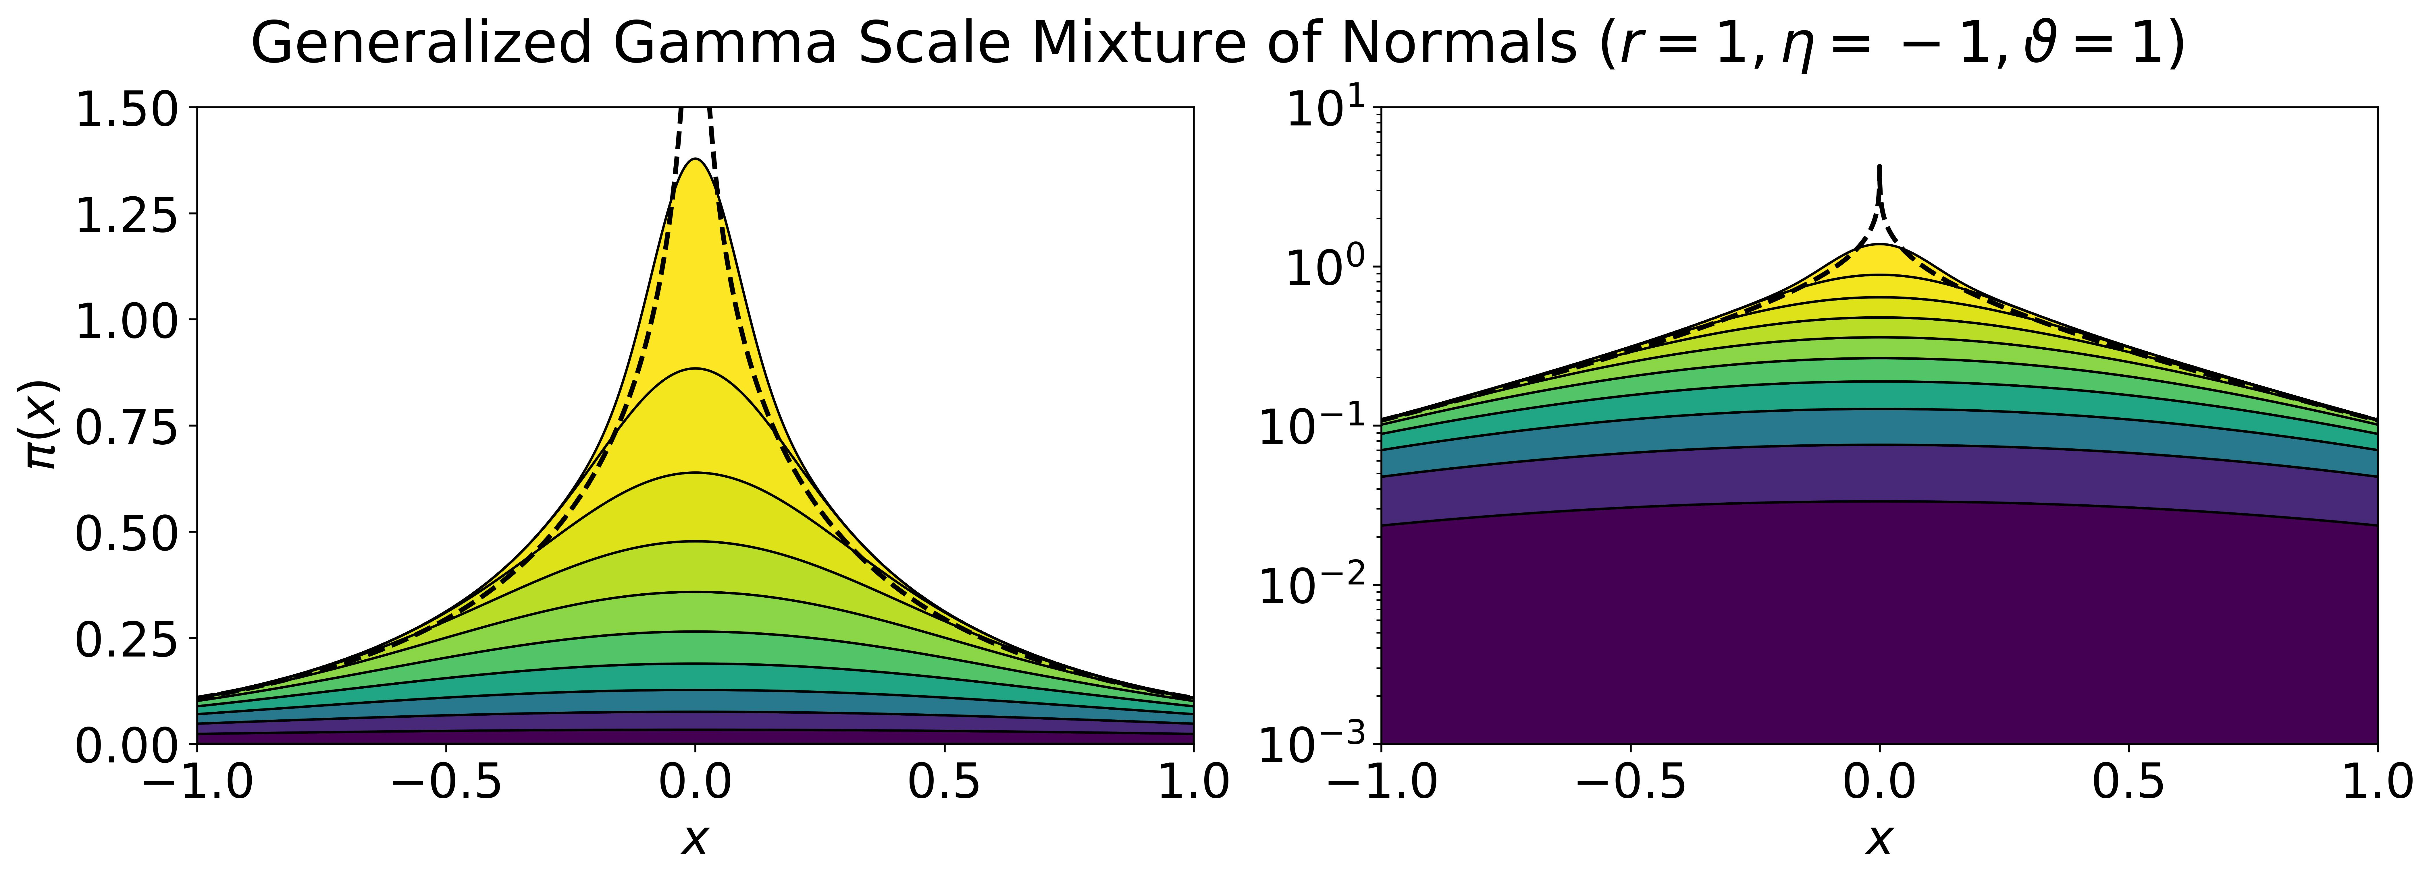
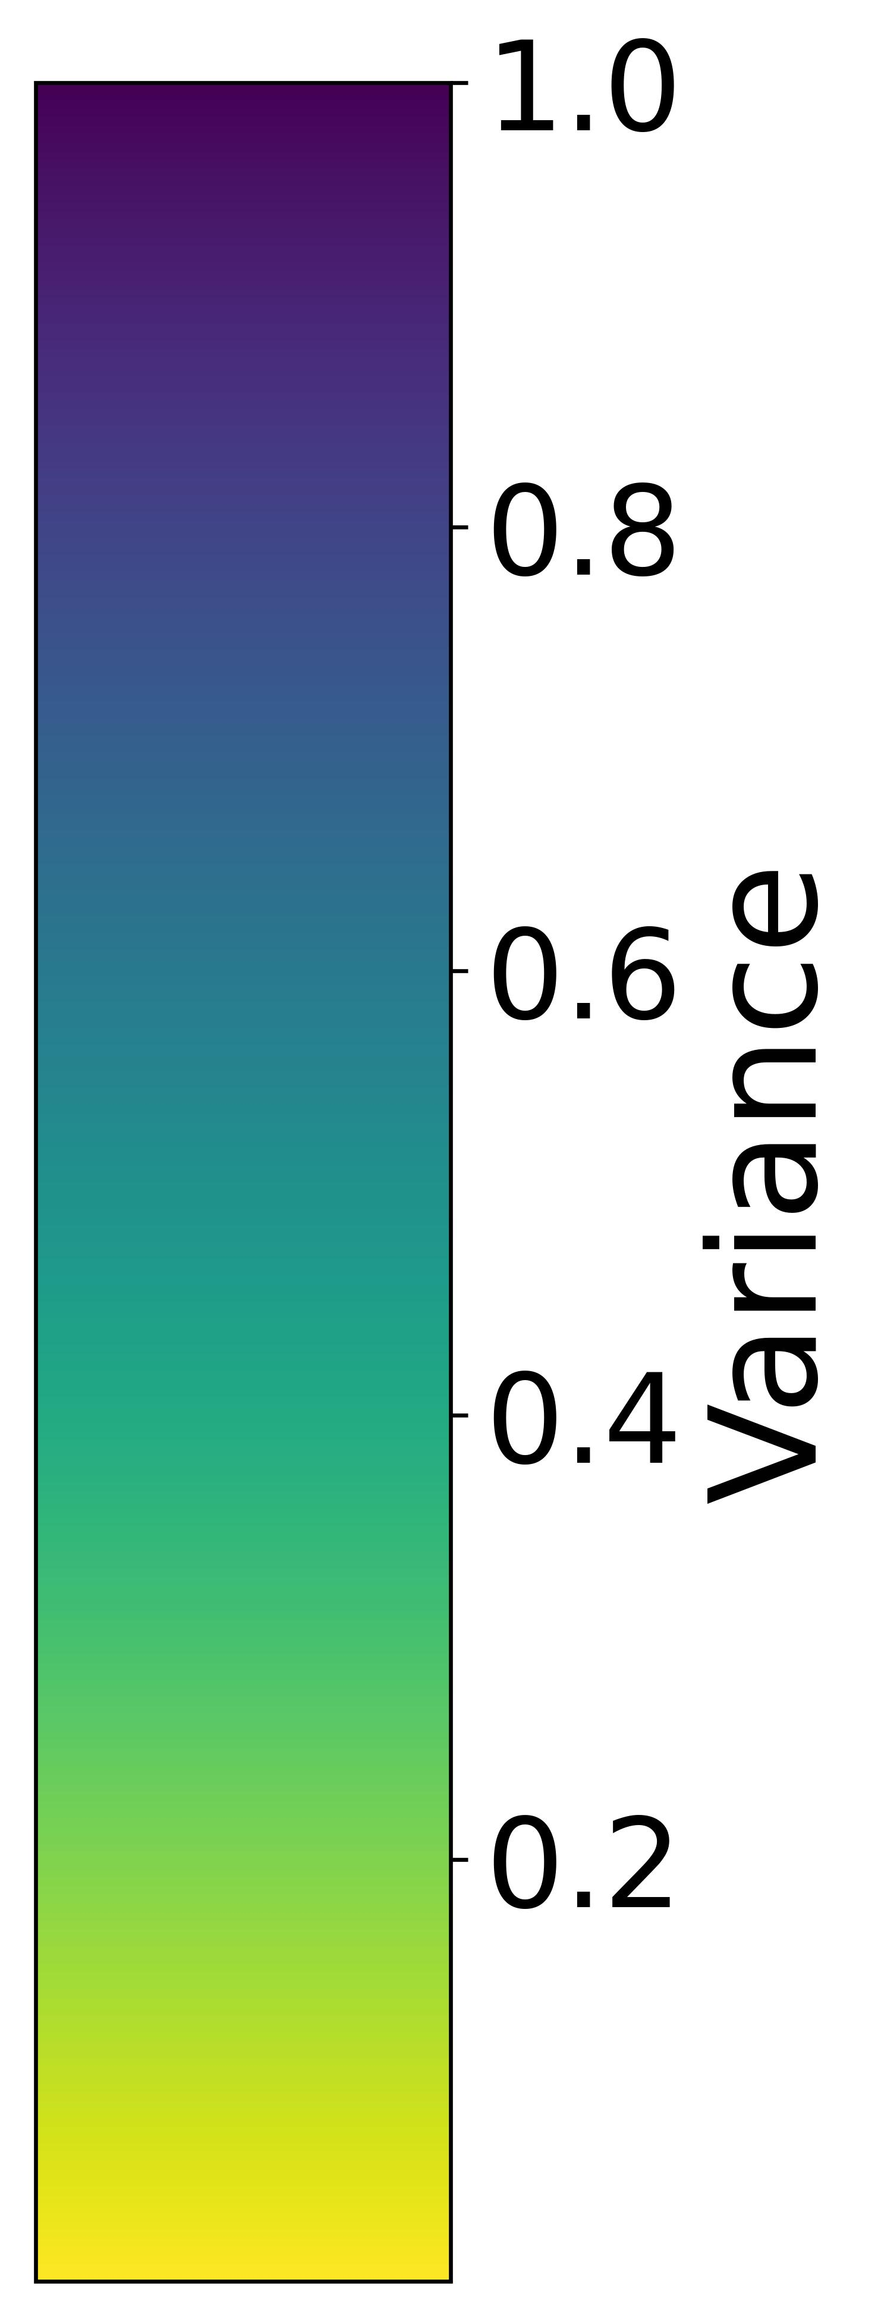

Slide 3
